Slide 1
Lecture 5: Introduction to Non Deterministic Finite Automata
Difference Between NFA and DFA
Working of NFA with Epsilon Transition
Example of NFA Computation
Presented by
Prof. Vaibhav Narayan Chunekar
K. J. Somaiya College off Engineering, Vidyavihar, Mumbai

Slide 2
NFA: Non Deterministic Finite Automata
Computation Proceed simultaneously to multiple path
From state Q, on an input symbol a, the automaton can go to multiple states.
NFA Compute Keen Closure path (K Path) with epsilon transition where k>=0

Slide 3
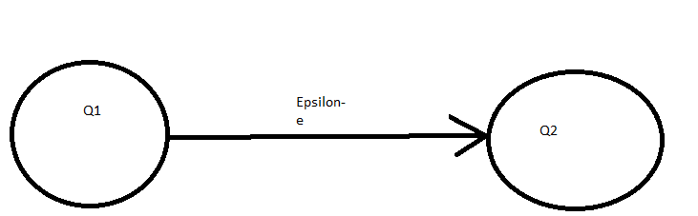
Epsilon Transition
NFA has an e transition.
If there is e transition then automaton moves state q_{i} and q_{j} without reading next input symbol.
An input is accepted if there is some computation path that leads to an accept state.

Slide 4
Difference between NFA and DFA
DFA | NFA
Deterministic Finite Automaton is a FA in which there is only one path for a specific input from current state to next state. There is a unique transition on each input symbol | NFA or Non Deterministic Finite Automaton is the one in which there exists many paths for a specific input from current state to next state.
DFA cannot use Empty String transition | NFA can use Empty String transition

Slide 5
Difference between NFA and DFA
DFA | NFA
DFA can be understood as one machine | NFA can be understood as multiple little machines computing at the same time
DFA will reject the string if it end at other than accepting state | If all of the branches of NFA dies or rejects the string, we can say that NFA reject the string.
For Every symbol of the alphabet, there is only one state transition in DFA. | We do not need to specify how the NFA reacts according to some symbol.

Slide 6
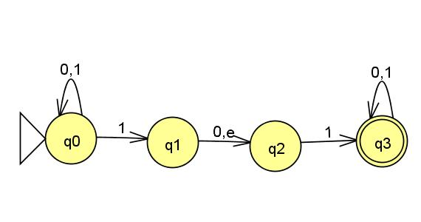
Example

Slide 7
Transition Table
State | Input | Next state
q0 | 1 | q0,q1
q1 | 1 | { }
q1 | 0 | q2
q1 | e | q1 ,q2
q2 | 1 | q3

Slide 8
Transition Table
State | Input | Next state
q2 | 0 | { }
q3 | 0 | q3
q3 | 1 | q3

Slide 9
Computation path with NFA
Input string W=010110
How does automaton proceed with computation on W?

Slide 10
Computation path with NFA
Set of states | Symbol Read➔010110 | Next State
q0(initial state) | 0 | q0
q0 | 1 | q0,q1,q2
q0,q1,q2 | 0 | Q0,q2
q0,q2 | 1 | Q0,q1,q2,q3
q0,q1,q2,q3 | 1 | q0,q1,q2,q3
q0,q1,q2,q3 | 0 | q0,q2,q3
q0,q2,q3(final set of states) | ⬅input is accepted if there is an accept state in the final set of states. | ⬅ Here q3 is accept state .Hence w is accepted by NFA.

Slide 11
Thanks..

